Slide 1

CAR DAtASET
NAME :Salomia Pillai
We have a dataset in this project that’s cars data and in this presentation we explain and understand the all data like car’s selling price, mileage, what’s the engine [CC] used and so many things.

Slide 2



CAR DATASET
things.We have a dataset in this project that’s cars data and in this presentation we explain and understand the all data like car’s selling price, mileage, what’s the engine [CC] used and so many
Significance of the analysis
Analysis is significant as it unveils insights hidden within data, guiding informed decisions. It transforms raw information into actionable knowledge, aiding problem-solving and strategy formulation. Through analysis, patterns emerge, allowing for predictive capabilities and optimization of outcomes. It empowers businesses, researchers, and policymakers to understand complexities and drive progress effectively. In essence, analysis is the cornerstone of informed decision-making in various domains.

Slide 3



CAR DATASET
We have a dataset in this project that’s cars data and in this presentation we explain and understand the all data like car’s selling price, mileage, what’s the engine [CC] used and so many things.
Key Columns
Transmission : The type of transmission (manual or automatic).
Owner : The number of previous owners of the car.
Mileage : The mileage of the car in kilometers per liter.
Engine [CC] : The engine displacement in cubic centimeters (CC).
Max Power : The maximum power output of the car's engine.
Seats : The number of seats in the car.
Name : The name or model of the car.
Year : The manufacturing year of the
Selling Price : The price at which the car was sold.
Km Driven : The number of kilometers driven by the car.
Fuel : The type of fuel the car uses.
Seller Type : The type of seller (individual, dealer, or Trustmark dealer).

Slide 4



CAR DATASET
Explain the SQL queries and methods
1. Read all the table from the data set ?
2. Group by the all fuel from the data set ?
3. Read the all name in Asending order ?
4. Read the Top 5 selling _price in desending order
5. Read the all name in desending order ?

Slide 5


CAR DATASET
Explain the SQL queries and methods
6. Read all name the table from dataset ?
7. Group by the all KM_DRVIEN from the data set?
8. Read all the tabel MAX_POWER from SUM the cars24 ?
9. Read all the tabel transmission from count the cars24 ?
10. Read all the tabel mileage from avg the cars24 ?

Slide 6

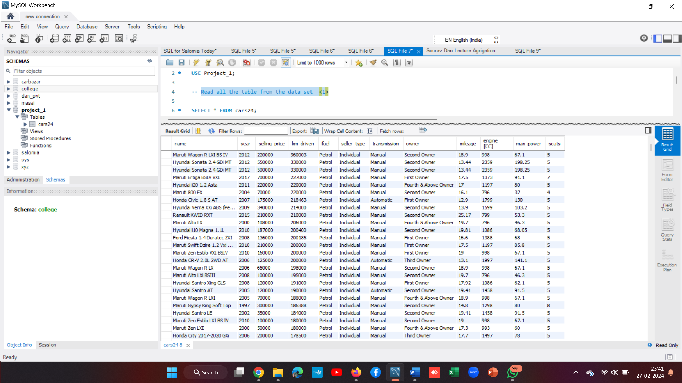
CAR DATASET
1. Read all the table from the data set ?

Slide 7

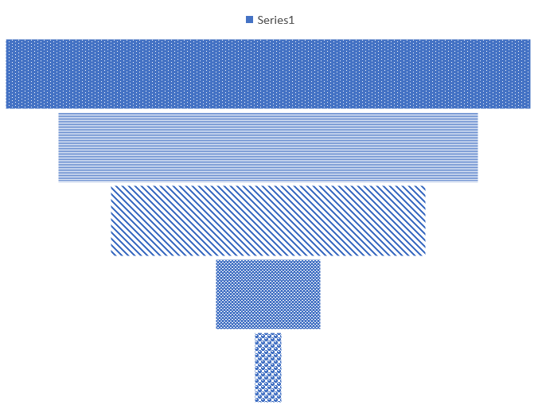
CAR DATASET
2. Group by the all fuel from the data set 2.
FUEL
PEROL
LNG
DISEAL
CNG

Slide 8

CAR DATASET
3. Read the all name in Asending order
Ambassador Grand 2000 DSZ PW CL
Ashok Leyland Stile LE
BMW 3 Series 320d Luxury Line
Chevrolet Aveo U-VA 1.2
Datsun GO Plus A
Fiat Avventura MULTIJET Emotion
Ford Figo Petrol EXI
Honda Amaze S i-VTEC
Honda Amaze S Option i-DTEC
Ford Figo Diesel Titanium

Slide 9

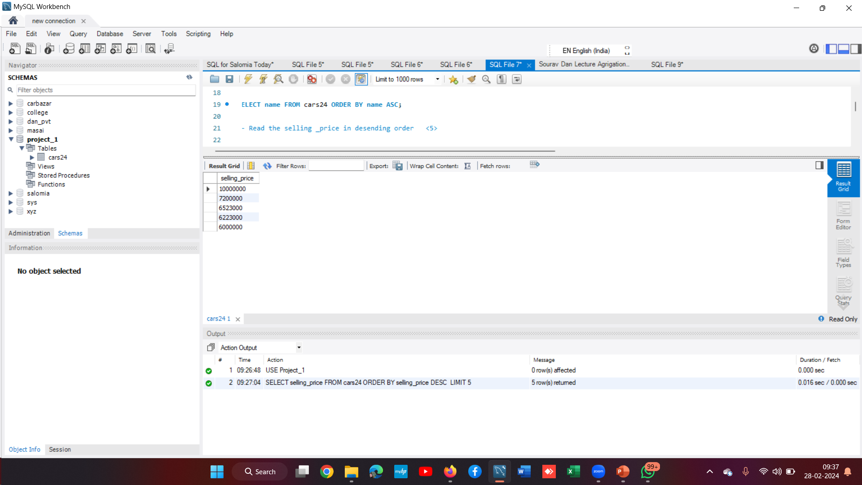
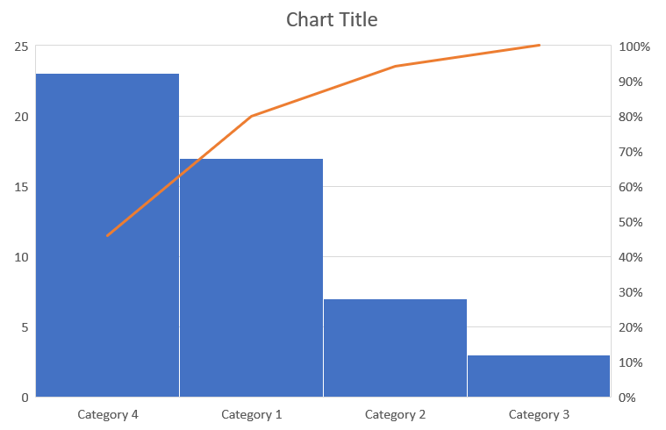
CAR DATASET
The Top 5 selling _price in desending order
7200000
10000000
6523000
6223000
60OOOOO

